Slide 1

Bearcat Circle
Bringing students together remotely

Slide 2

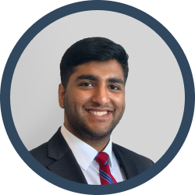


Team Members
Giang Ta
Computer Science
tagh@mail.uc.edu
Sim Singh
Computer Engineering
singh2s7@mail.uc.edu
Nathan Berning
Computer Science
berninnt@mail.uc.edu
Ryan Gruss
Computer Science
grussra@mail.uc.edu
Advisor
Dr. Yizong Cheng - chengy@ucmail.uc.edu

Slide 3
Problem
Remote learning makes it difficult to interact with other students.
Notes:
Distance learning is isolating and makes student interactions more difficult.

Slide 4




Goals
Provide an easy-to-use online platform for students to collaborate
Centralize
existing online communication applications
Increase Student Engagement in a remote setting

Slide 5
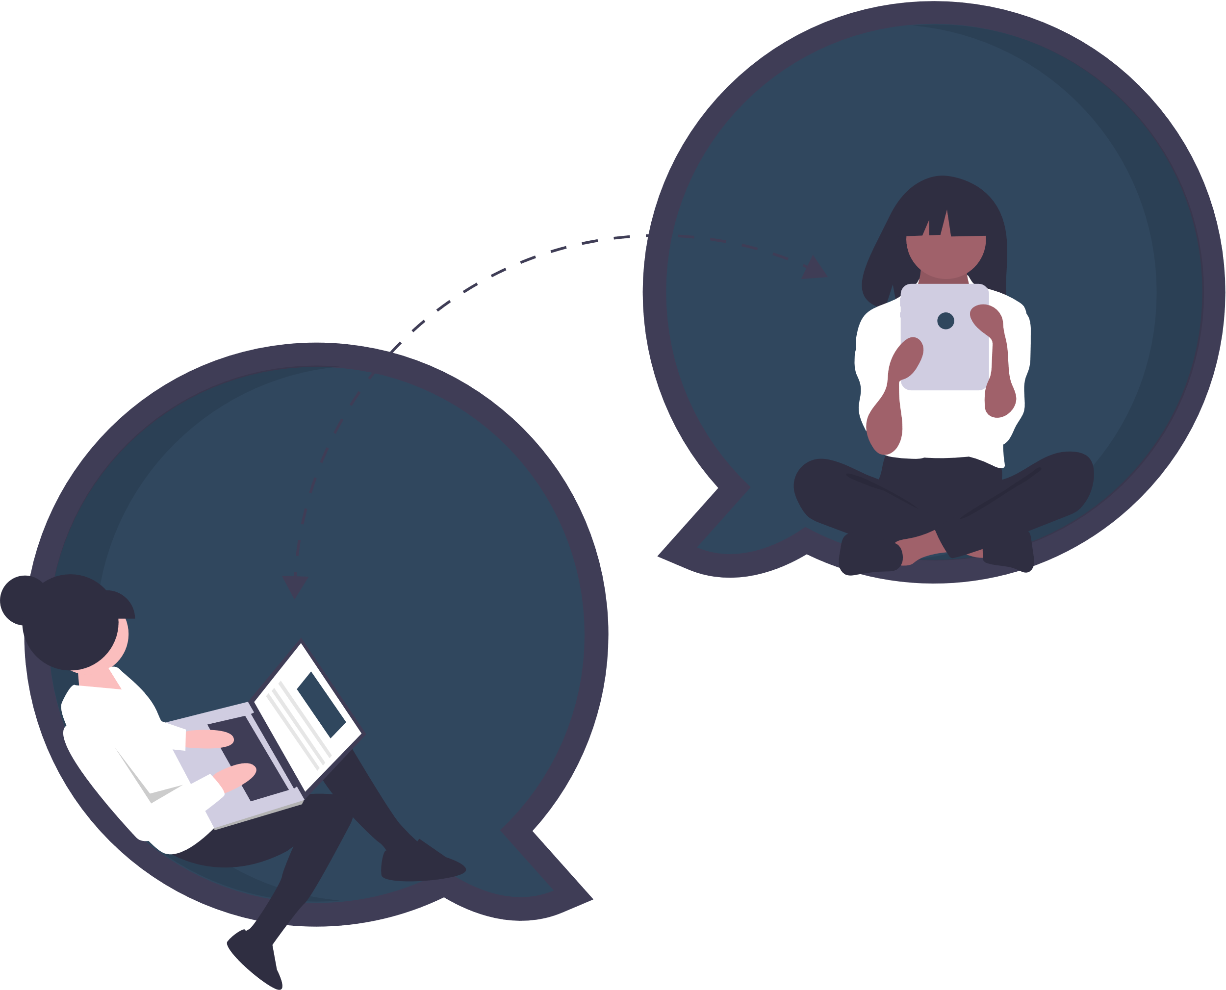
Intellectual Merits
While applications like Slack, Teams and Discord exist for communication, they do little to encourage interactions with other students.
A student would need to go through multiple steps to find a community or student to connect with.
Bearcat Circle provides a solution to the question: “How can I meet other students?”.

Slide 6
Our Approach – Web App
Simple
Centralized
An easy to use interface
Reduce the need for multiple similar applications
Scalable
Interactive
Easily adjust for additonal capacity
Drive interactions within the UC community

Slide 7
Broader Impacts
Inclusivivity
Learning
Relationships
Provide a more inclusive environment at UC
Make learning a more collaborative experience
Build diverse relationships and communities

Slide 8



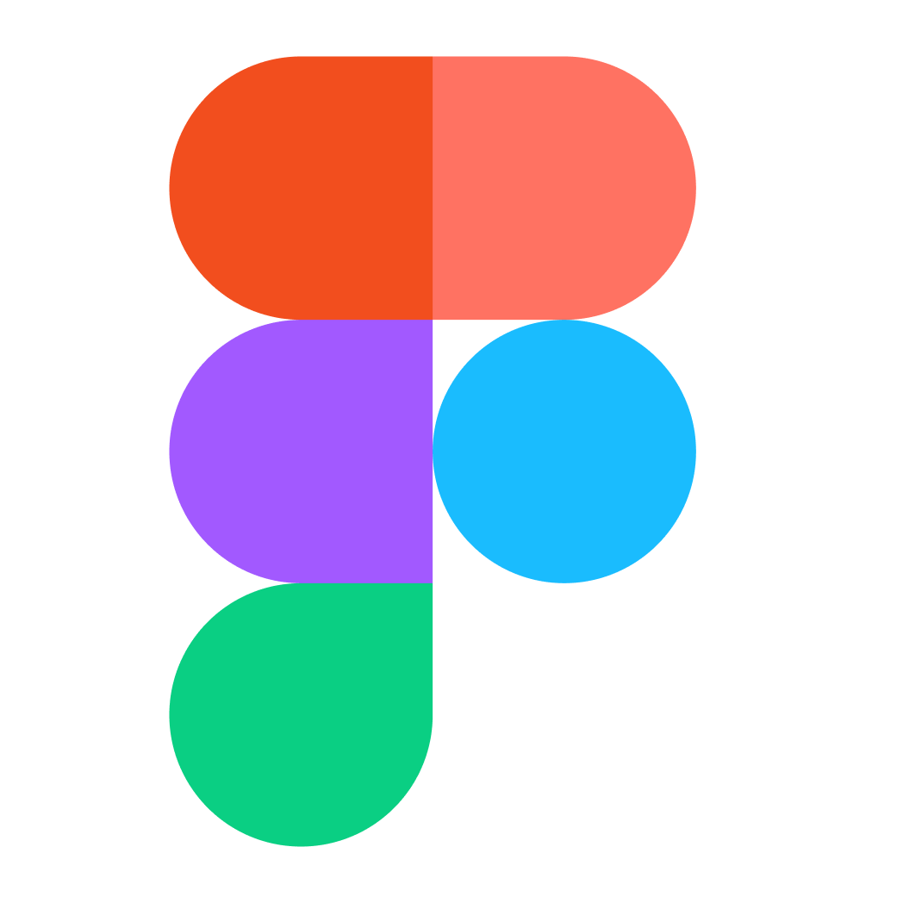

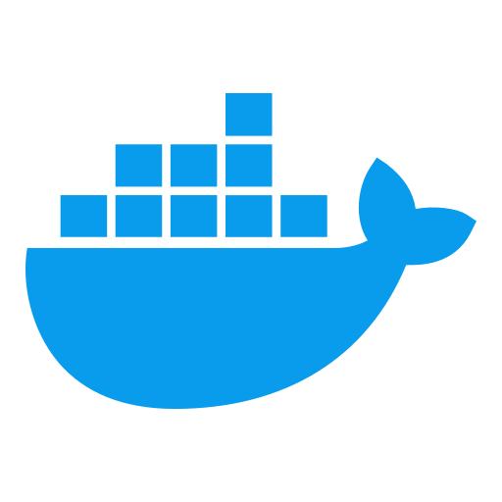


Technologies
Figma – Design
ReactJs – Web Framework
SocketIO – Chat
FastAPI – API
PostgresSQL – Database
Docker – App Containers
Pytest – Python Testing
Jest – Javascript Testing
Front-end
Back-end
Build/Test
Notes:
Front End:
React JS – a front end JavaScript library for building user interfaces or UI components for single-page applications.
Back End:
SocketIO – a Javascript library that enables real-time, bidirectional and event-based communication for both front and back-end of an appilcation
FastAPI – high performance and lightweight Python web framework for building API applications, adhering to modern design.
Deployment/Build tools/Testing:
Docker – container-based software for building and packaging applications in different environments
Pytest – Python unit test framework
Jest – Javascript unit test framework

Slide 9
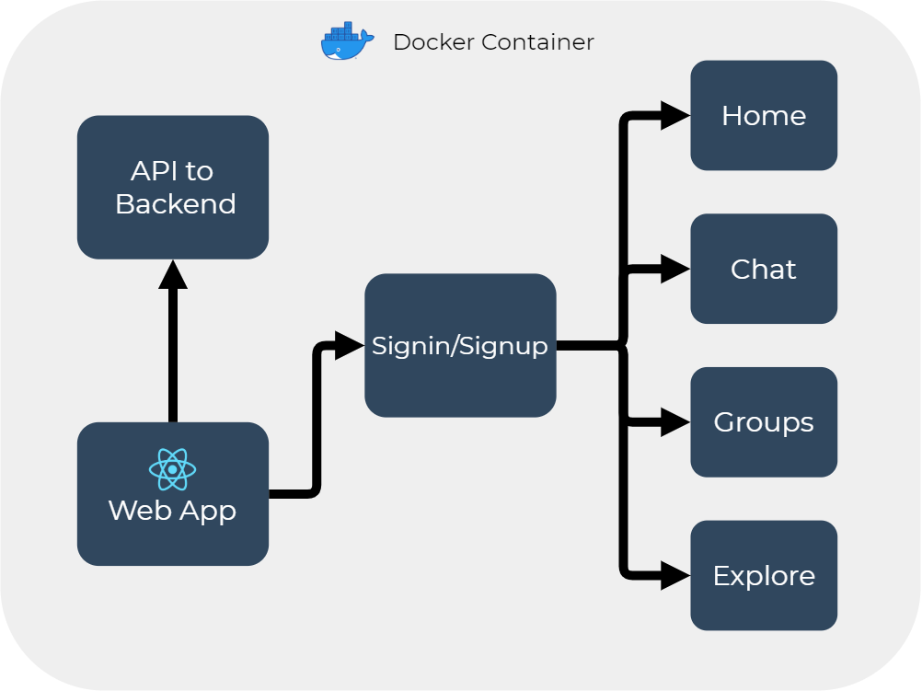
Front-end
Design Diagram

Slide 10
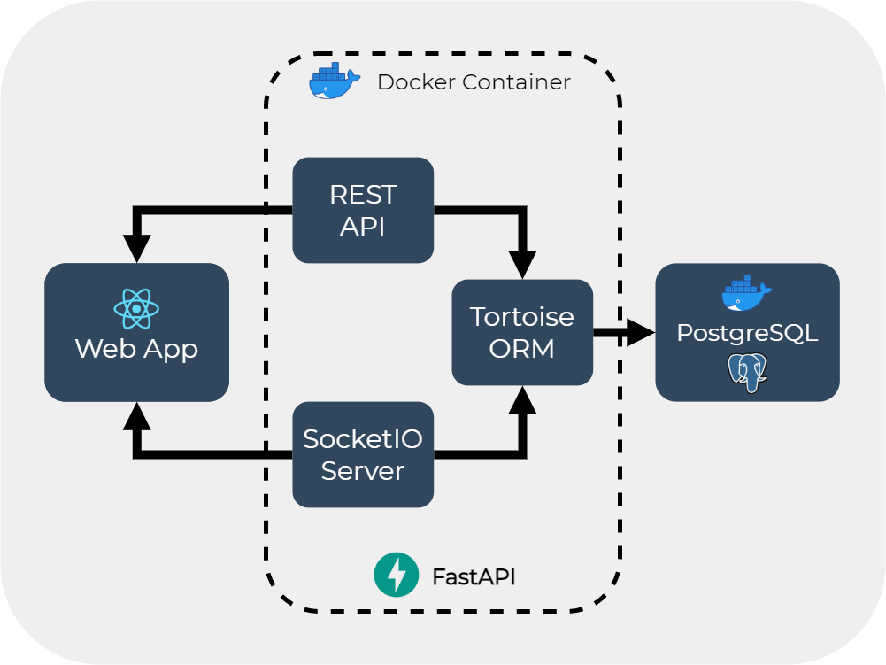
Back-end
Design Diagram

Slide 11
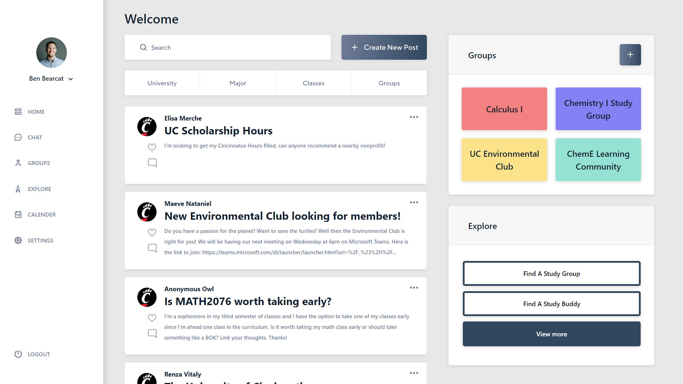
Demo
Student Perspective

Slide 12
Milestones
Version | Description | Start | End | Length
1 | Finalize Research and Design | 1/11 | 1/25 | 2 Weeks
2 | Build Front End Architecture and Basic APIs | 1/25 | 2/15 | 3 Weeks
3 | Develop Core Features and create containers | 2/15 | 3/15 | 4 Weeks
4 | Finalize Features and Test Functionality | 3/15 | 3/26 | 2 Weeks

Slide 13
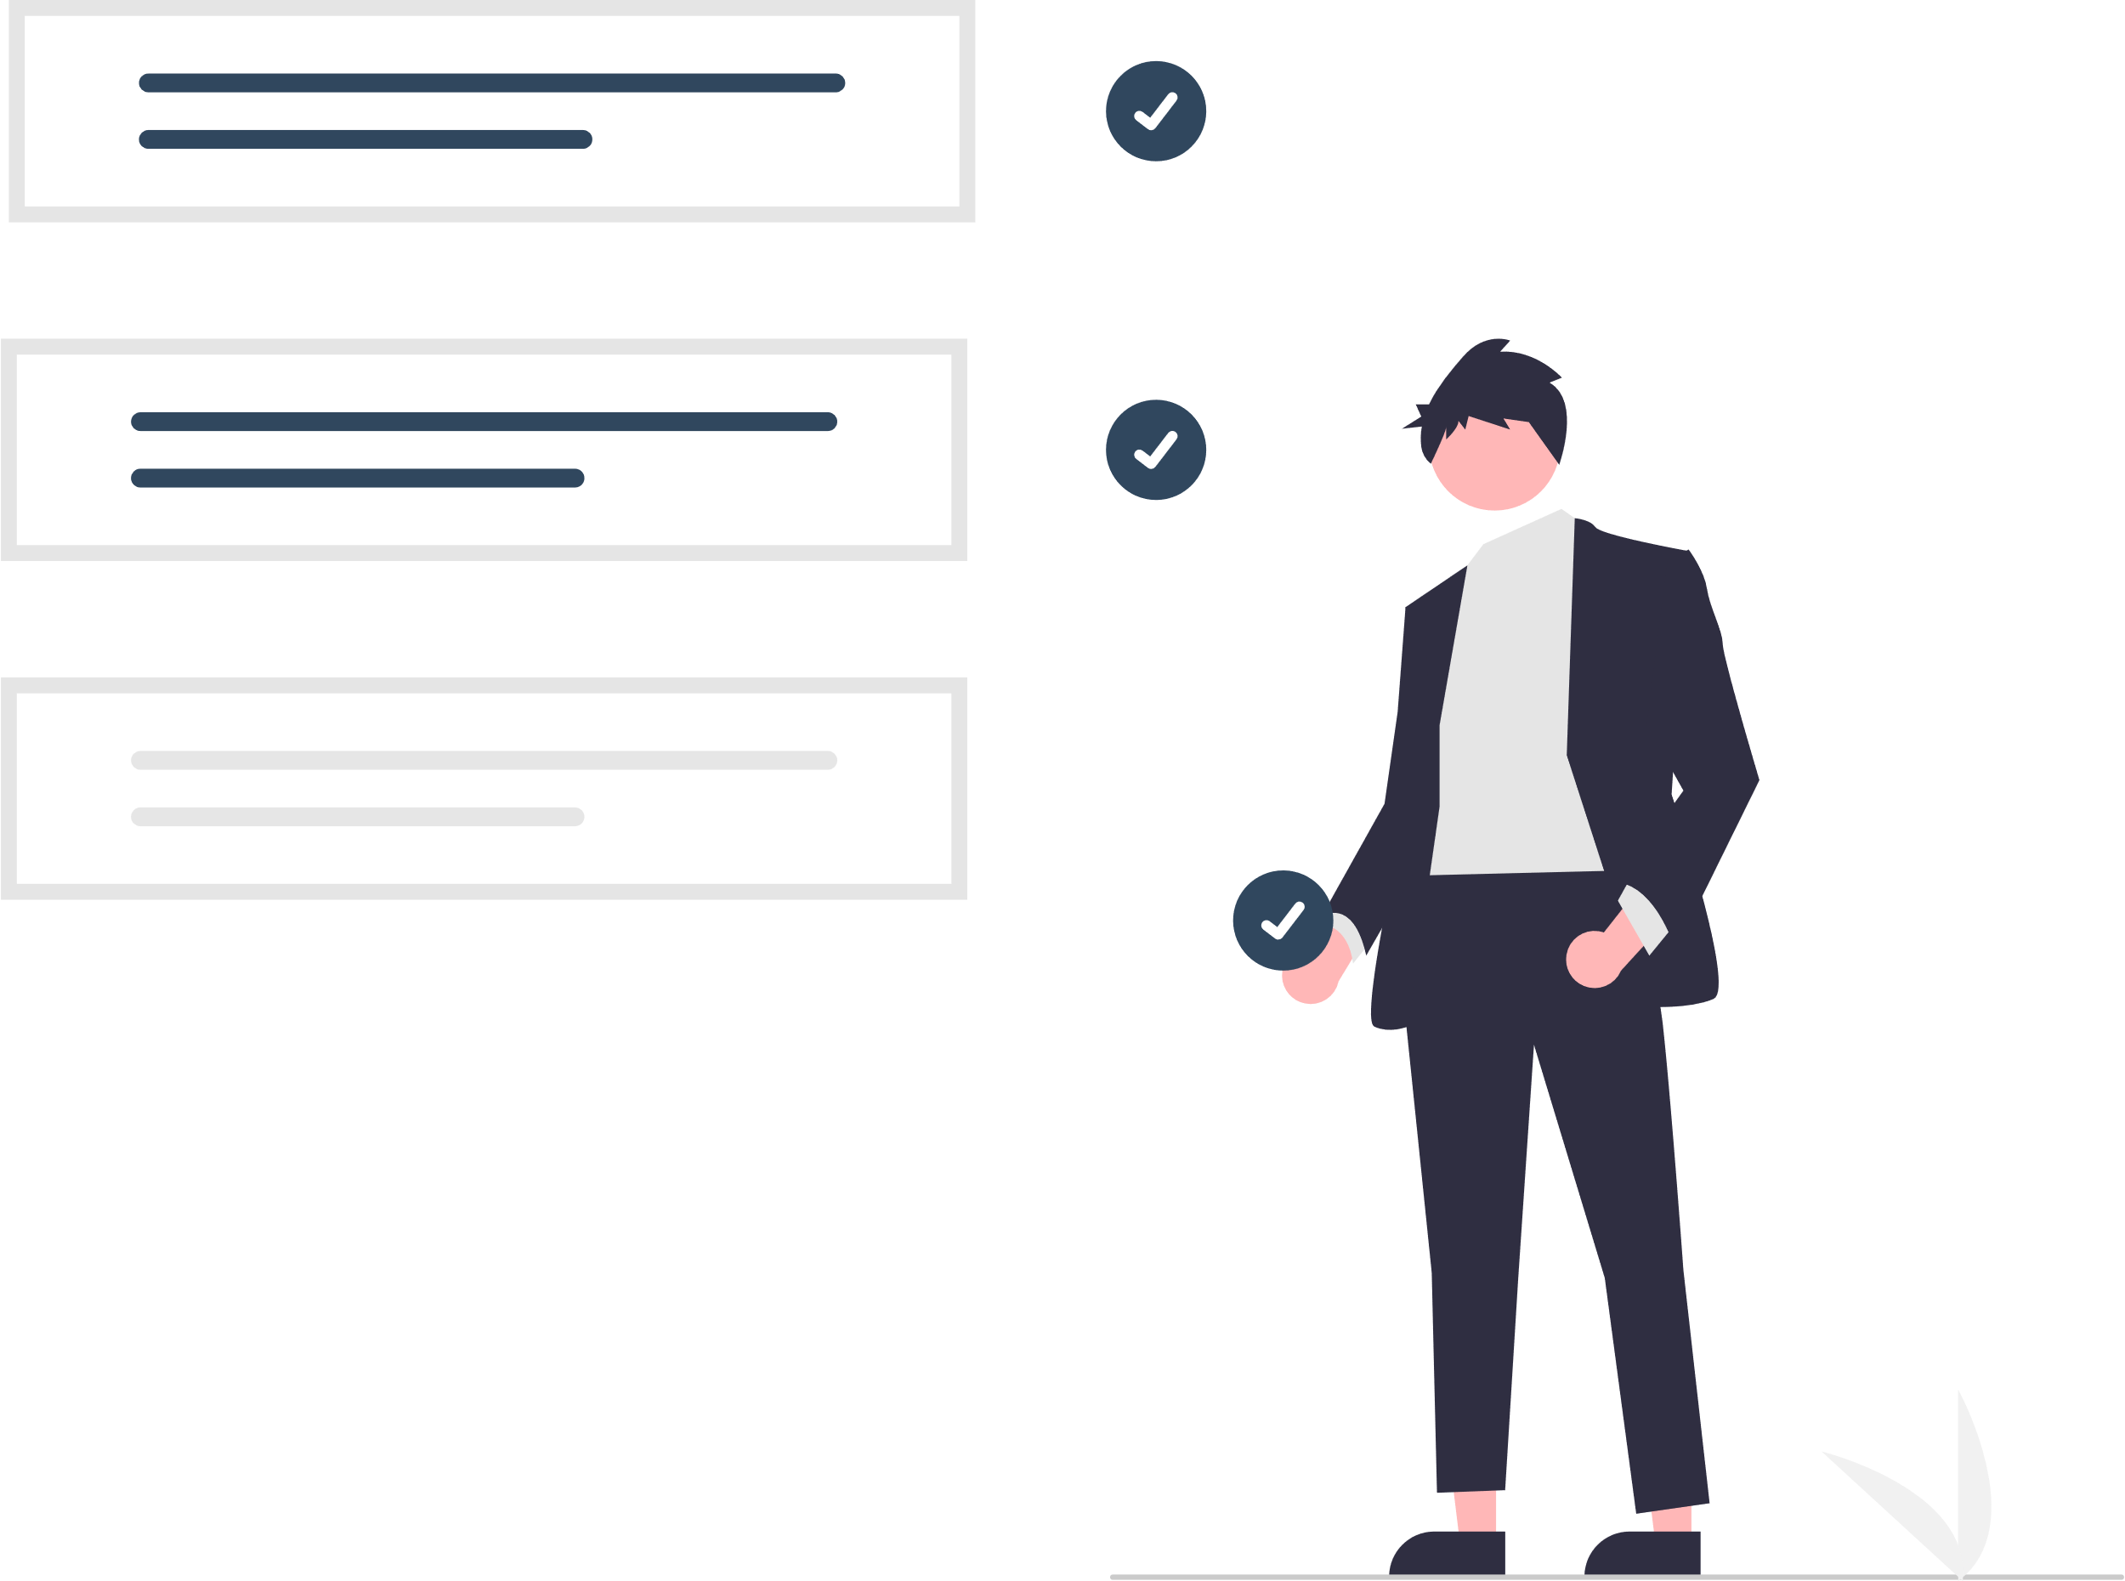
Challenges
Research
Learning multiple new technologies quickly
Learning about User Experience and Interface
Design
Applying design research
Creating different layouts for specific pages
Designing database and relationships
Development
Connecting Front-end to Back-end
Converting Figma Sketch to React Front-end
Seperating into Docker Containers

Slide 14
Results
Figma Mockup
Components for multiple pages
Forum and chat functionality
Simple Interface
APIs for forum, chat, signup
Database storage for forum and chat
Store user information
Docker containers
Testing for both Front-end and Back-end
API docs with FastAPI
Front-end
Back-end
Build

Slide 15
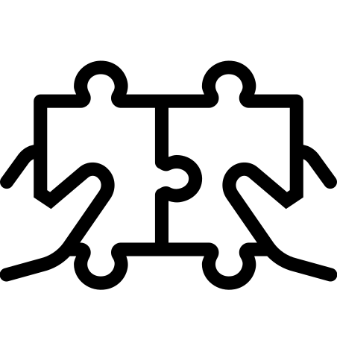
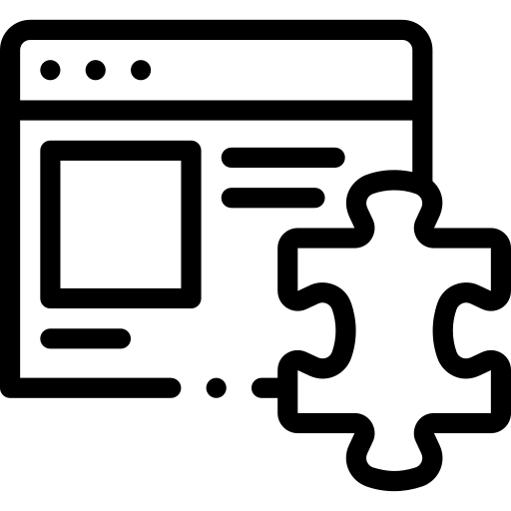

Next Steps
Smart Matching
Plugins
Templates

Slide 16
Thank You

